Slide 1




High-Quality Methods
Design and Implement High-Quality Methods. Cohesion and Coupling
High-Quality Code
SoftUni Team
Technical Trainers
Software University
http://softuni.bg

Slide 2

Table of Contents
Why Do We Need Methods?
Method-Level Cohesion and Coupling
Strong Cohesion
Loose Coupling
Method Parameters
Pseudocode

Slide 3

Why Do We Need Methods?

Slide 4
Why Do We Need Methods?
Methods (functions, routines) are important in software development
Reduce complexity
Divide and conquer
Complex problems are split into composition of smaller problems
Improve code readability
Small methods with good method names make the code self-documenting
Avoid duplicating code
Duplicating code is hard to maintain

Slide 5

Why We Need Methods? (2)
Methods simplify software development
Hide implementation details
Complex logic is encapsulated and hidden behind a simple interface
Algorithms and data structures are hidden and can be transparently replaced later
Increase the level of abstraction
Methods address the business problem, not the technical implementation:
Bank.Accounts[customer].Deposit(500);

Slide 6
Using Methods: Fundamentals
The fundamental principle of correct method usage:
A method should do exactly what its name says
Nothing less (work correctly in all possible scenarios)
Nothing more (no side effects)
In case of incorrect input or incorrect preconditions
An error should be returned (e.g. throw exception)
A method should do what its name says or should indicate an error (throw an exception). Any other behavior is incorrect!

Slide 7

Bad Methods – Examples
What will happen if we sum 2,000,000,000 + 2,000,000,000?
int Sum(int[] elements)
{
int sum = 0;
foreach (int element in elements)
{
sum = sum + element;
}
return sum;
}
Result: -294967296
What will happen if a = b = c = -1?
double CalcTriangleArea(double a, double b, double c)
{
double s = (a + b + c) / 2;
double area = Math.Sqrt(s * (s - a) * (s - b) * (s - c));
return area;
}
The same result as when a = b = c = 1 → both triangles have the same size.

Slide 8
Good Methods – Examples
long Sum(int[] elements)
{
long sum = 0;
foreach (int element in elements)
{
sum = sum + element;
}
return sum;
}
double CalcTriangleArea(double a, double b, double c)
{
if (a <= 0 || b <= 0 || c <= 0)
{
throw new ArgumentException("Sides should be positive.");
}
double s = (a + b + c) / 2;
double area = Math.Sqrt(s * (s - a) * (s - b) * (s - c));
return area;
}

Slide 9
Indicating an Error
Some methods do not indicate errors correctly
If the property name does not exist
A null reference exception will be thrown (implicitly) → it is not meaningful
internal object GetValue(string propertyName)
{
PropertyDescriptor descriptor =
this.propertyDescriptors[propertyName];
return descriptor.GetDataBoundValue();
}

Slide 10
Indicating an Error (2)
Use the correct exception handling instead:
internal object GetValue(string propertyName)
{
PropertyDescriptor descriptor =
this.propertyDescriptors[propertyName];
if (descriptor == null)
{
throw new ArgumentException("Property name: "
+ propertyName + " does not exists!");
}
return descriptor.GetDataBoundValue();
}

Slide 11
Symptoms of Wrong Methods
Method that does something different than its name is wrong for at least one of these reasons:
The method sometimes returns incorrect result → bug
The method returns incorrect result when its input is incorrect → low quality
Could be acceptable for private methods only
The method does too many things → bad cohesion
The method has side effects → spaghetti code
Method returns strange value when an error condition happens → it should indicate the error

Slide 12
Wrong Methods – Examples
long Sum(int[] elements)
{
long sum = 0;
for (int i = 0; i < elements.Length; i++)
{
sum = sum + elements[i];
elements[i] = 0; // Hidden side effect
}
return sum;
}
double CalcTriangleArea(double a, double b, double c)
{
if (a <= 0 || b <= 0 || c <= 0)
{
return 0; // Incorrect result
}
double s = (a + b + c) / 2;
double area = Math.Sqrt(s * (s - a) * (s - b) * (s - c));
return area;
}

Slide 13
Strong Cohesion
Methods should have strong cohesion
Should address single task and address it well
Should have clear intent
Methods that address several tasks in the same time are hard to be named
Strong cohesion is used in engineering
In computer hardware any PC component solves a single task
E.g. hard disk performs a single task – storage

Slide 14
Acceptable Types of Cohesion
Functional cohesion (independent function)
Method performs certain well-defined calculation and returns a single result
The entire input is passed through parameters and the entire output is returned as result
No external dependencies or side effects
Math.Sqrt(value) → square root
char.IsLetterOrDigit(ch)
string.Substring(str, startIndex, length)

Slide 15
Acceptable Types of Cohesion (2)
Sequential cohesion (algorithm)
Method performs certain sequence of operations to perform a single task and achieve certain result
It encapsulates an algorithm
Example:
Connect to mail server
Send message headers
Send message body
Disconnect from the server
SendEmail(recipient, subject, body)

Slide 16
Acceptable Types of Cohesion (3)
Communicational cohesion (common data)
A set of operations used to process certain data and produce a result
Example:
Retrieve input data from database
Perform internal calculations over retrieved data
Build the report
Format the report as Excel worksheet
Display the Excel worksheet on the screen
DisplayAnnualExpensesReport(int employeeId)

Slide 17
Acceptable Types of Cohesion (4)
Temporal cohesion (time related activities)
Operations that are generally not related but need to happen in a certain moment
Examples:
Load user settings
Check for updates
Load all invoices from the database
Sequence of actions to handle the event
InitializeApplication()
ButtonConfirmClick()

Slide 18
Unacceptable Cohesion
Logical cohesion
Performs a different operation depending on an input parameter
Incorrect example:
Can be acceptable in event handlers
E.g. the KeyDown event in Windows Forms)
object ReadAll(int operationCode)
{
if (operationCode == 1) … // Read person name
else if (operationCode == 2) … // Read address
else if (operationCode == 3) … // Read date
…
}

Slide 19
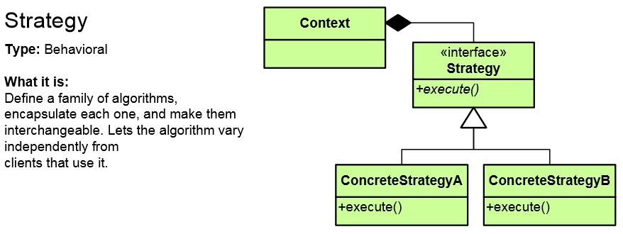
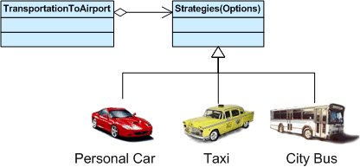
Strategy Pattern
Encapsulates an algorithm inside a class
Making each algorithm replaceable by others
All the algorithms can work with the same data transparently
The client can work with each algorithm transparently
http://www.dofactory.com/net/strategy-design-pattern

Slide 20
Strategy Pattern – Example
abstract class SortStrategy {
public abstract void Sort(IList<object> list);
}
class QuickSort : SortStrategy {
public override void Sort(IList<object> list) { ... }
}
class MergeSort : SortStrategy {
public override void Sort(IList<object> list) { ... }
}
class SortedList {
private IList<object> list = new List<object>();
public void Sort(SortStrategy strategy) {
// sortStrategy can be passed in constructor
sortStrategy.Sort(list);
}
}

Slide 21
Unacceptable Cohesion
Coincidental cohesion (spaghetti)
Not related (random) operations grouped in a method for unclear reason
Incorrect example:
Prepares annual incomes report for given customer
Sorts an array of integers in increasing order
Calculates the square root of given number
Converts given MP3 file into WMA format
Sends email to given customer
HandleStuff(customerId, int[], ref sqrtValue, mp3FileName, emailAddress)

Slide 22
Loose Coupling
What is loose coupling?
Minimal dependences of the method on the other parts of the source code
Minimal dependences on the class members or external classes and their members
No side effects
If the coupling is loose, we can easily reuse a method or group of methods in a new project
Tight coupling → spaghetti code

Slide 23
Loose Coupling (2)
The ideal coupling
A methods depends only on its parameters
Does not have any other input or output
Example: Math.Sqrt()
Real world
Complex software cannot avoid coupling but could make it as loose as possible
Example: complex encryption algorithm performs initialization, encryption, finalization

Slide 24
Coupling – Example
Intentionally increased coupling for more flexibility (.NET cryptography API):
byte[] EncryptAES(byte[] inputData, byte[] secretKey)
{
Rijndael cryptoAlg = new RijndaelManaged();
cryptoAlg.Key = secretKey;
cryptoAlg.GenerateIV();
MemoryStream destStream = new MemoryStream();
CryptoStream csEncryptor = new CryptoStream(
destStream, cryptoAlg.CreateEncryptor(),
CryptoStreamMode.Write);
csEncryptor.Write(inputData, 0, inputData.Length);
csEncryptor.FlushFinalBlock();
byte[] encryptedData = destStream.ToArray();
return encryptedData;
}

Slide 25
Loose Coupling – Example
To reduce coupling we can make utility classes
Hide the complex logic and provide simple straightforward interface (a.k.a. façade):
byte[] EncryptAES(byte[] inputData, byte[] secretKey)
{
MemoryStream inputStream = new MemoryStream(inputData);
MemoryStream outputStream = new MemoryStream();
EncryptionUtils.EncryptAES(
inputStream, outputStream, secretKey);
byte[] encryptedData = outputStream.ToArray();
return encryptedData;
}

Slide 26
Tight Coupling – Example
Passing parameters through class fields
Typical example of tight coupling
Don't do this unless you have a good reason!
class Sumator
{
public int a, b;
int Sum()
{
return a + b;
}
static void Main()
{
Sumator sumator = new Sumator() { a = 3, b = 5 };
Console.WriteLine(sumator.Sum());
}
}

Slide 27
Tight Coupling in Real World Code
Say, we have a large piece of software
We need to update subsystems and the subsystems are not really independent
E.g. a change in filtering affects sorting, etc:
class GlobalManager
{
public void UpdateSorting() {…}
public void UpdateFiltering() {…}
public void UpdateData() {…}
public void UpdateAll () {…}
}

Slide 28
Cohesion Problems in Real-World Code
Say, we have an application consisting of two layers:
Do not update top-down and bottom-up from a single method!
E.g. RemoveCustomer() method in the DataLayer changes also the presentation layer
Better use a notification (observer pattern / event)
Presentation Layer
Data Layer

Slide 29
Loose Coupling and OOP
Reducing coupling with OOP techniques
Abstraction
Define a public interface and hide the implementation details
Encapsulation
Make methods and fields private unless they are definitely needed
Define new members as private
Increase visibility as soon as this is needed

Slide 30
Acceptable Coupling
Method is coupled to its parameters
This is the best type of coupling
Method in a class is coupled to some class fields
This coupling is usual, do not worry too much
Method in a class is coupled to static methods, properties or constants in an external class
static int Sum(int[] elements) { … }
static int CalcArea() { return this.Width * this.Height; }
static double CalcCircleArea(double radius)
{ return Math.PI * radius * radius; }

Slide 31
Non-Acceptable Coupling
Method in a class is coupled to static fields in external class
Use private fields and public properties
Methods take as input data some fields that could be passed as parameters
Check the intent of the method
Is it designed to process internal class data or is utility method?
Method is defined public without being part of the public class' interface → possible coupling

Slide 32
Method Parameters
Put most important parameters first
Put the main input parameters first
Put non-important optional parameters last
Example:
Incorrect example:
void RegisterUser(string username, string password,
Date accountExpirationDate, Role[] roles)
void RegisterUser(Role[] roles, string password, string username,
Date accountExpirationDate)
void RegisterUser(string password, Date accountExpirationDate, Role[] roles, string username)

Slide 33
Methods Parameters (2)
Do not modify the input parameters
Use new variables instead
Incorrect example:
Correct example:
bool CheckLogin(string username, string password)
{
username = username.ToLower();
// Check the username / password here …
}
bool CheckLogin(string username, string password)
{
string usernameLowercase = username.ToLower();
// Check the username / password here …
}

Slide 34
Method Parameters (3)
Use parameters consistently
Use the same names and the same order in all methods
Incorrect example:
Output parameters should be put last
void EncryptFile(Stream input, Stream output, string key);
void DecryptFile(string key, Stream output, Stream input);
FindCustomersAndIncomes(Region region,
out Customer[] customers, out decimal[] incomes)

Slide 35
Pass Entire Object or Its Fields?
When should we pass an object containing few values and when these values separately?
Sometime we pass an object and use only a single field of it
Is this a good practice?
Examples:
Look at the method's level of abstraction
Is it intended to operate with employees of with rates and months? → the first is incorrect
CalculateSalary(Employee employee, int months);
CalculateSalary(double rate, int months);

Slide 36
How Many Parameters a Method Should Have?
Limit the number of parameters to 7 (+/-2)
7 is a "magic" number in psychology
Human brain cannot process more than 7 (+/-2) things in the same time
If the parameters need to be too many, reconsider the method's intent
Does it have a clear intent?
Consider extracting few of the parameters in a new class

Slide 37
Method Length
How long should a method be?
There is no specific restriction
Avoid methods longer than one screen (30 lines)
Long methods are not always bad
Be sure you have a good reason for their length
Cohesion and coupling are more important than the method length!
Long methods often contain portions that could be extracted as separate methods with good names and clear intent

Slide 38

Pseudocode
Pseudocode can be helpful in:
Routines design
Routines coding
Code verification
Cleaning up unreachable branches in a routine

Slide 39
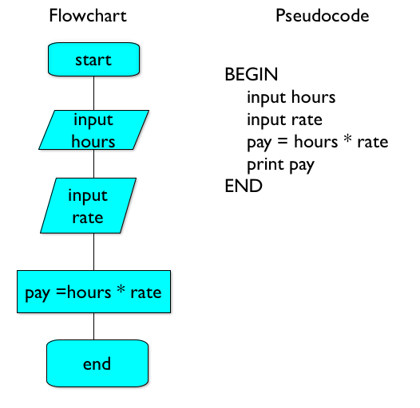
Designing in Pseudocode
What the routine will abstract i.e. the information a routine will hide?
Routine input parameters
Routine output
Preconditions
Conditions that have to be true before a routine is called
Postconditions
Conditions that have to be true after routine execution

Slide 40
Design Before Coding
Why it is better to spend time on design before you start coding?
The functionality may be already available in a library, so you do not need to code at all!
You need to think of the best way to implement the task considering your project requirements
If you fail on writing the code right the first time, you need to know that programmers get emotional to their code

Slide 41
Pseudocode Example
Routine that evaluates an aggregate expression for a database column (e.g. Sum, Avg, Min)
Parameters: Column Name, Expression
Preconditions:
Check whether the column exists and throw an argument exception if not
If the expression parser cannot parse the expression throw an ExpressionParsingException
Routine code: Call the evaluate method on the DataView class and return the resulting value as string

Slide 42
Public Routines in Libraries
Public routines in libraries and system software are hard to change
Because customers want no breaking changes
Two reasons why you need to change a public routine:
New functionality has to be added conflicting with the old features
The name is confusing and makes library usage unintuitive or inconvenient
Design better upfront, or refactor carefully

Slide 43
Method Deprecation
Deprecated method
About to be removed in future versions
When deprecating an old method
Include that in the documentation
Specify the new method that has to be used
Use the [Obsolete] attribute in .NET
[Obsolete("CreateXml() method is deprecated. Use CreateXmlReader instead.")]
public void CreateXml (…) { … }

Slide 44
Inline Routines
Inline routines (in C / C++) provide two benefits:
Performance benefit of not creating a new routine on the stack
Abstraction – use a well named routine, instead of inlined code
Some applications (e.g. games) need that optimization
Used for the most frequently used routines
Example: a short routine called 100,000 times
Not all languages support inline routines
The C# compiler inlines routines at compile time when necessary

Slide 45

Recursion
To Understand Recursion, One Must First Understand Recursion

Slide 46

Recursion
Useful when you want to walk (traverse) trees or graph-like structures
Be aware of infinite recursion or indirect recursion
Recursion example:
void PrintWindowsRecursive(Window w)
{
w.Print()
foreach(childWindow in w.ChildWindows)
{
PrintWindowsRecursive(childWindow);
} }

Slide 47
Recursion Tips
Ensure that recursion has an end (bottom)
Verify that recursion is not very high-cost
Check the occupied system resources
You can always use stack classes and iteration
Don't use recursion when there is better linear (iteration based) solution, e.g.
Factorials
Fibonacci numbers
Some languages optimize tail-call recursions

Slide 48

High-Quality Methods
Exercises in Class

Slide 49

Summary
Designing methods
No single solution
There are various tradeoffs
Choosing the best approach
Evaluate the requirements
Choose the most appropriate solution
Try to be flexible if the requirements change
Ensure strong cohesion and loose coupling

Slide 50









High-Quality Methods
httpshttps://softuni.bg/courses/oop/

Slide 51

License
This course (slides, examples, demos, videos, homework, etc.) is licensed under the "Creative Commons Attribution-NonCommercial-ShareAlike 4.0 International" license
Attribution: this work may contain portions from
"Fundamentals of Computer Programming with C#" book by Svetlin Nakov & Co. under CC-BY-SA license
"High Quality Code" course by Telerik Academy under CC-BY-NC-SA license

Slide 52






Free Trainings @ Software University
Software University Foundation – softuni.org
Software University – High-Quality Education, Profession and Job for Software Developers
softuni.bg
Software University @ Facebook
facebook.com/SoftwareUniversity
Software University @ YouTube
youtube.com/SoftwareUniversity
Software University Forums – forum.softuni.bg

